Slide 1
AUTOMATIC PLANT IRRIGATION SYSTEM
Guide:
Anju Jose
Asst.Professor
ECE Department
CEP,Poonjar
Group no-5
Antony Jose

Slide 2
CONTENTS
Abstract.
Introduction.
Block diagram.
Circuit diagram.
Sub circuit diagram.
working.
Design of circuit.
Components required.
Implementation.
Advantage.
Disadvantage.
Conclusion.

Slide 3
ABSTRACT
The project describes about watering plants automatically without human interference
A metal probe is inserted in the soil.
If soil is dry it has high resistance and if soil is wet it has low resistance .
The metal prob sense the condition with 7404 IC it complement the input.
It trigger the first NE555 timer act as Monostable multivibrator ,output connected to second NE555 timer configured as astable multivibrator.
It switch ON the transistor which switch ON relay then switch to the DC motor connected to it.
The motor pump the water to soil.
Soil wet, the motor automatically OFF.

Slide 4
INTRODUCTION
This is a simple project more useful in watering plants automatically without human interference
We may call it as AUTOMATIC PLANT IRRIGATION SYSTEM .
We know that people do not pour water to the plants in their garden when they go to vacation or often forget to water plants.
As a result there is a chance to get plants damaged.
This project is an excellent solution for such kind of problems.

Slide 5
BLOCK DIAGRAM OF AUTOMATIC PLANT IRRIGATION SYSTEM
PROBES INSERTED
IN SOILOR GROUND
7404 IC HEX
INVERTER
NE555
TIMER
SWITCH ON
TRANSISTOR
FLOW WATER
TO SOIL
DC MOTOR
RELAY

Slide 6
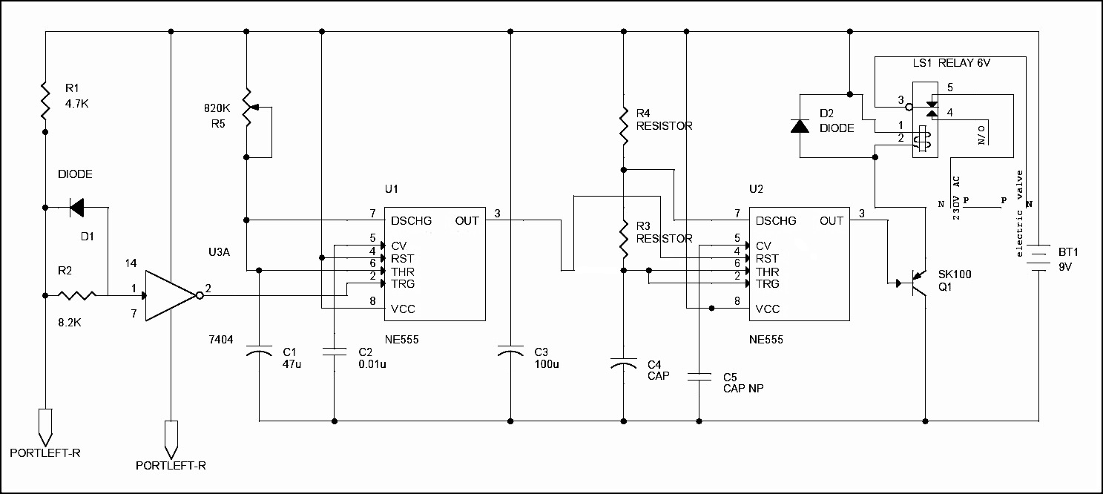
CIRCUIT DIAGRAM

Slide 7
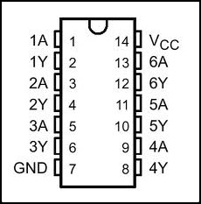
HEX INVERTER

Slide 8
WORKING
Insert a metal probe YL69 in the soil, is a moisture sensing probe.
When soil is wet it has low resistance and when soil is dry it has high resistance ,when soil is dry large voltage drop occurs.
This condition is sensed by the hex inverter IC7404.
The complemented output is connected to the pin (2) of the first NE555 act as a monostable multivibrator which trigger the input.
Output of first NE555 pin (3) connected to the second NE555 which act as astable multivibrator at pin(4) is a reset pin.
The output of second NE555 at pin (3) is connected to the base of the transistor
Transistor switch ON the relay and relay switch ON the dc motor which pump the water to the soil
Soil become wet the motor OFF automatically .
The power supply used is 9v.

Slide 9
COMPONENTS REQUIRED
RESISTOR'S
R1=4.7K
R2=8.2K
R3=27K
R4=27K
R5=820K(VARIABLE RESISTOR)
CAPACITORS
.C1=47U
C2=0.01U
C3=100U
C4=10U,16V
C5=0.01U
DIODES
D1=IN4148
D2=IN4148
.TRANSISTOR=SK100
.RELAY=6V .150 OHMS
IC=7404.(NOT GATE)
. ELECTRIC VALVE OR SWITCH
NE555=TIMER IC (2 no.)
METAL PROB
DC MOTOR=12V
BATTERY=9V

Slide 10
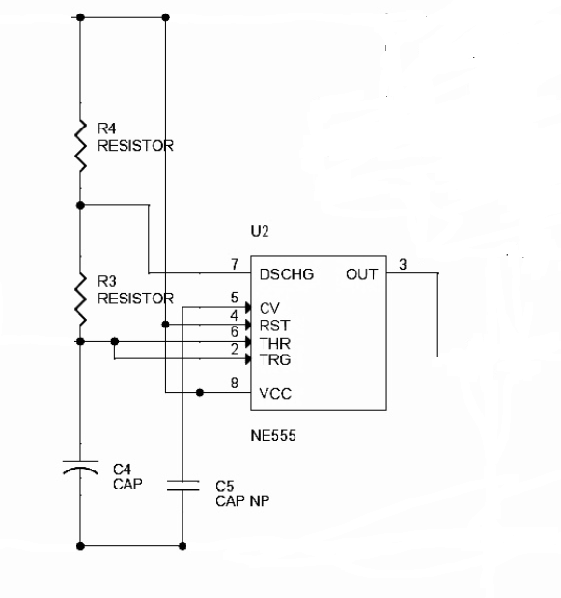
DESIGN OF THE CIRCUIT
ASTABLE MULTIVIBRATOR
VCC=9V AND TC=1MS,TD=0.5MS
TC=0.69(RA+RB)C
TD=0.69RBC
RA=27K,RB=27K
C=0.01U.

Slide 11
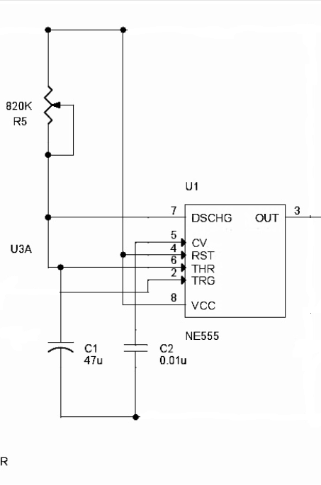
MONOSTABLE MULTIVIBRATOR
VCC=9V, T=1MS
T=1.1RC
TAKE R=820K to limit the the current through internal transistor to mA and c1=47u,c2=0.01u.

Slide 12
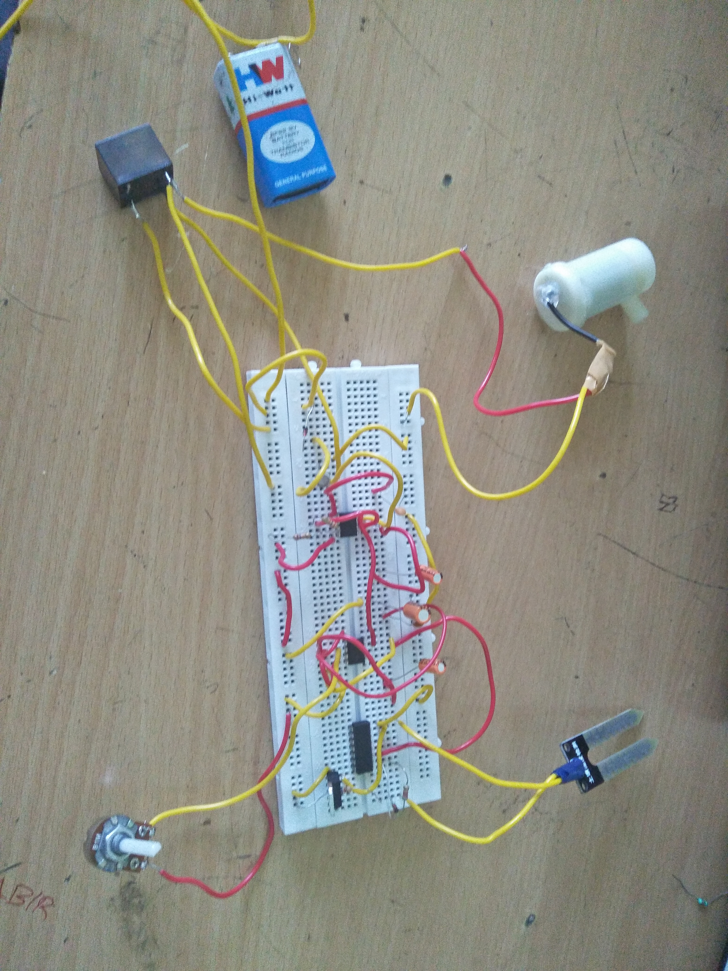
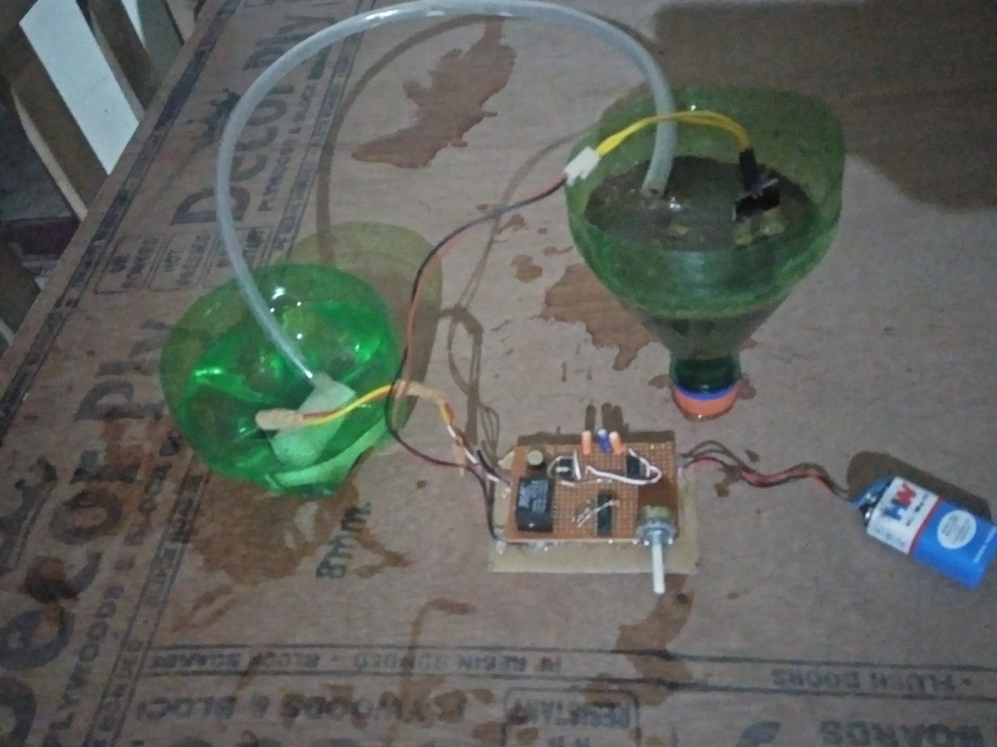
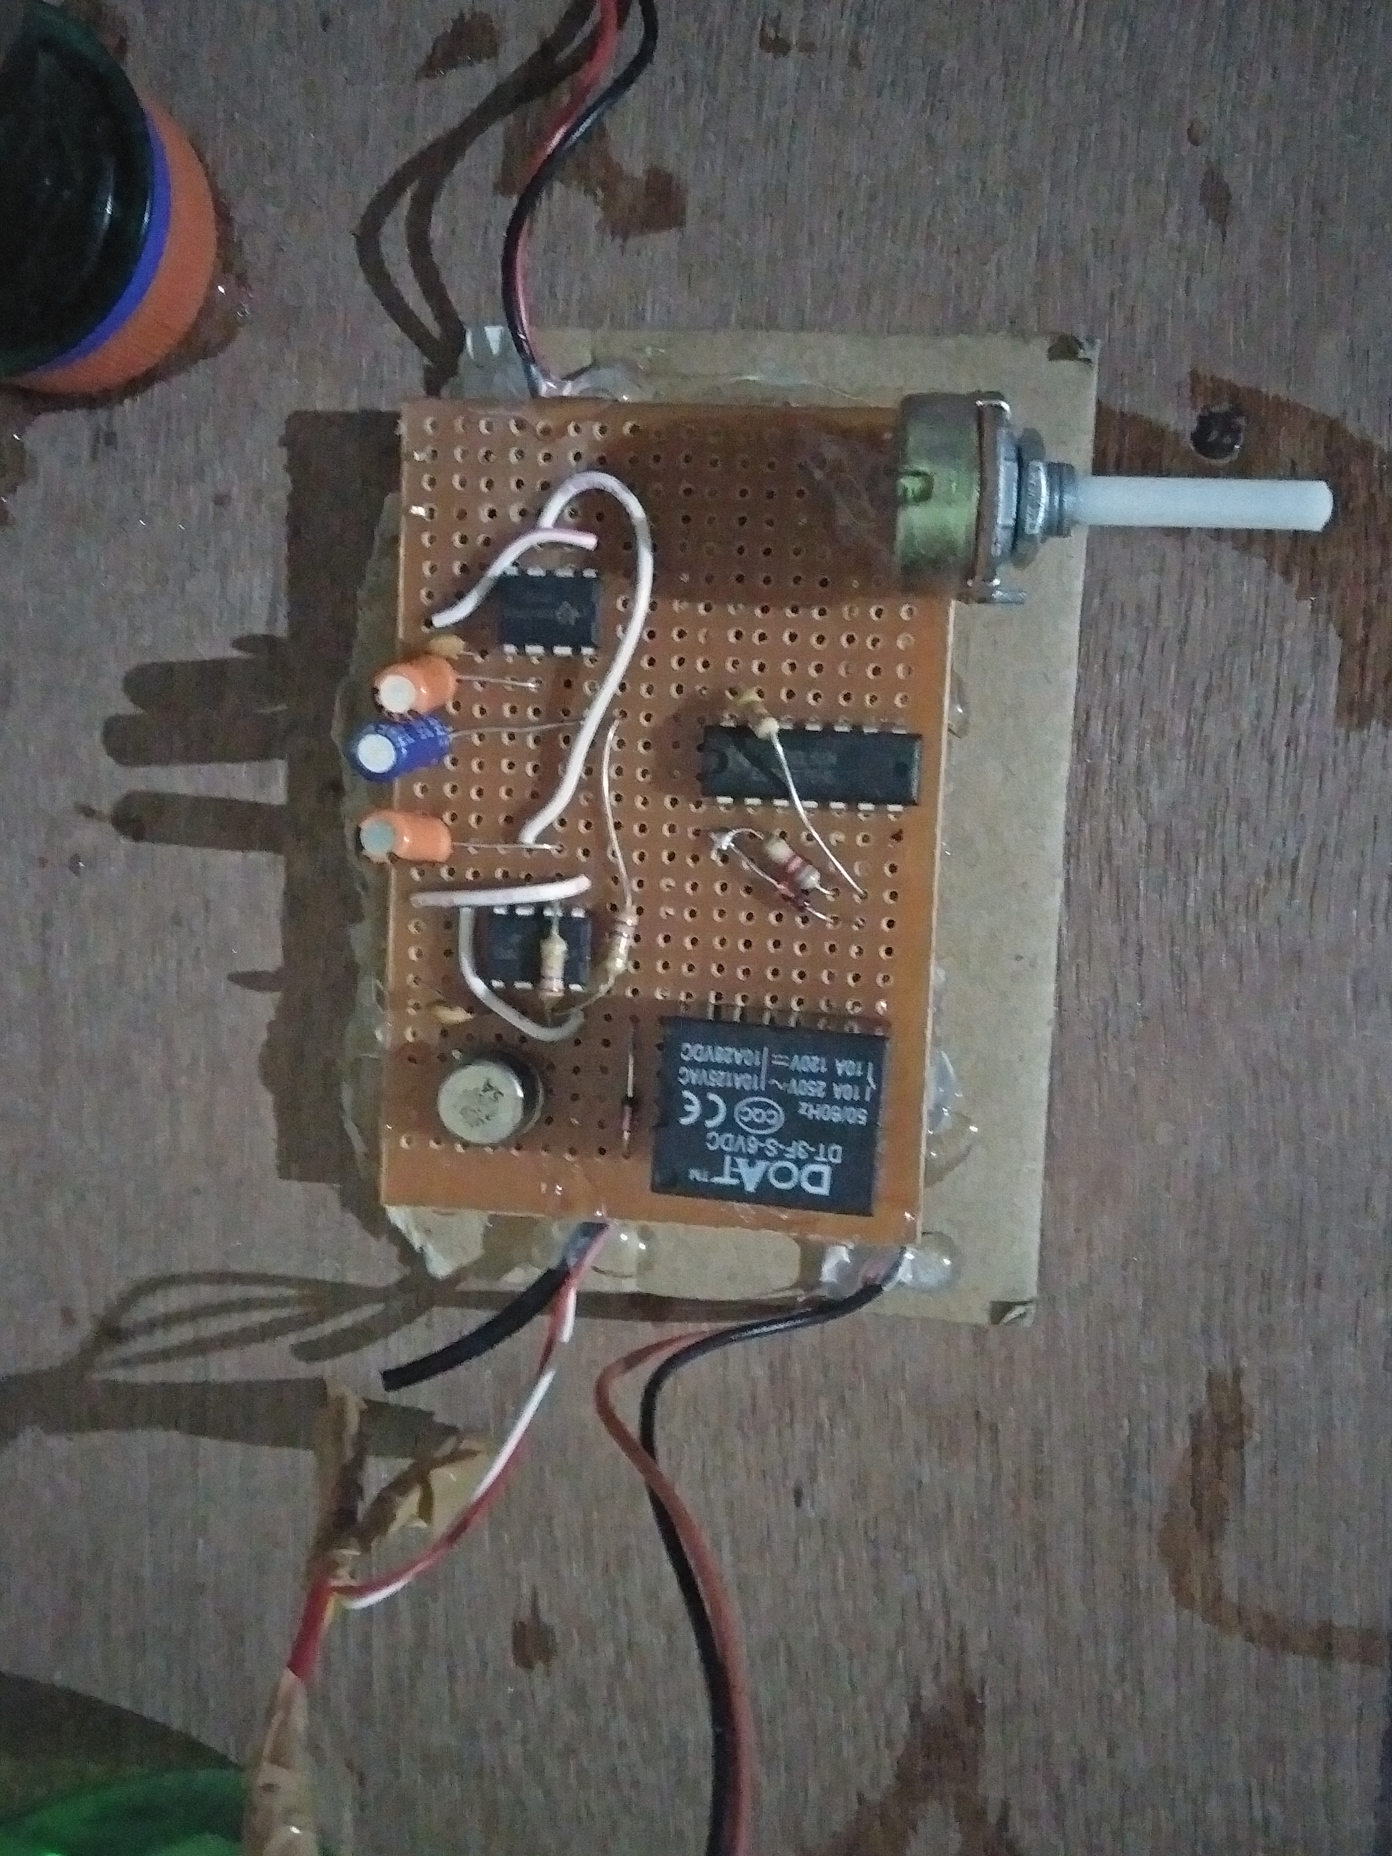
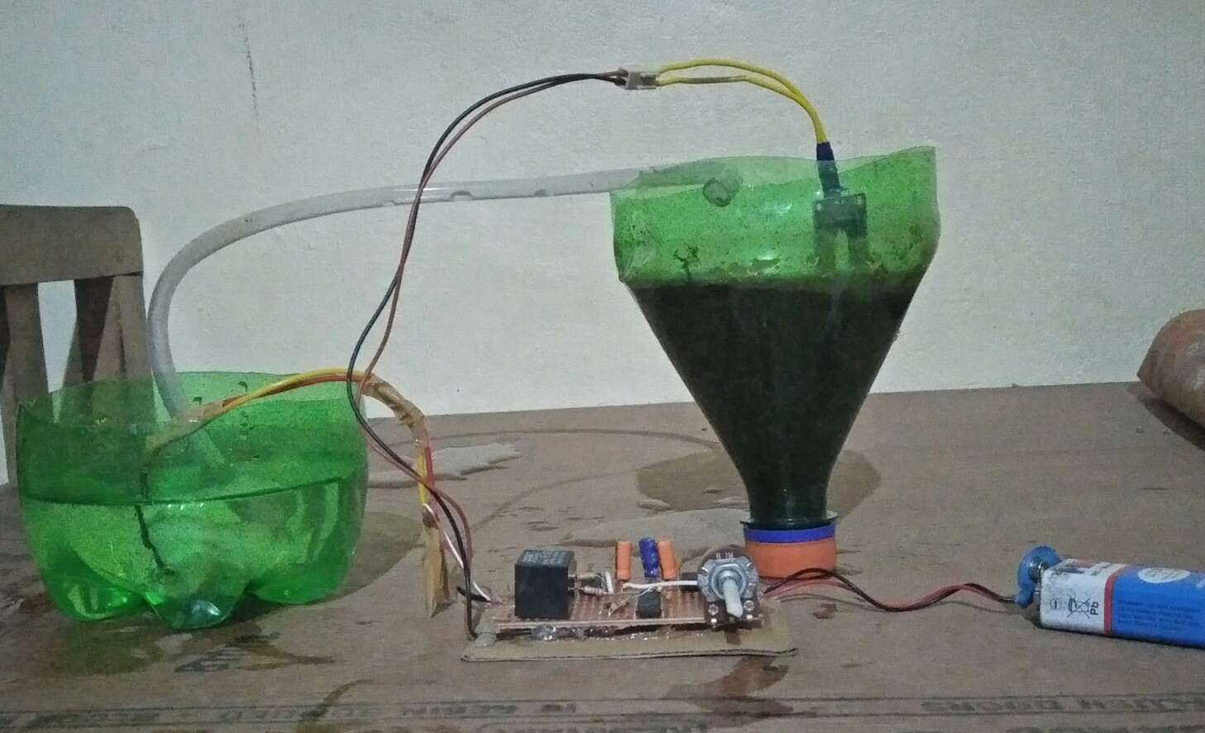
IMPLEMENTATION

Slide 13
ADVANTAGES
Low cost project
Elimination of man power
Switch to manual mode
Capable of conserving water
Discouraging weeds
Time saving.

Slide 14
DISADVANTAGES
Battery should be continuously monitored from power outage .
Probes should be inserted in to the soil.they should not be kept on the soil
Have limited life after installation due to the deterioration of plastic components in hot,arid climate when exposed to ultraviolet

Slide 15
CONCLUSION
The project has been sucessfully executed and output obtained.
It Pump water to the soil automatically without human interference.
It saves the time and also applicable in the gardens.
If soil is dry, it automatically switch on the motor and pump water to the field.
It is a simple and cost effective technology for farming.

Slide 16
THANK YOU….

